Slide 1
Notes:
Opening slide

Slide 2
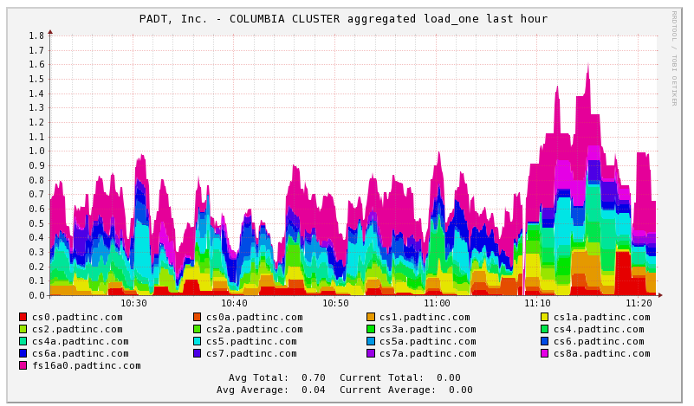
Agenda
Introduction to living in a Numerical Simulation world
Hardware & Tools for HPC
HPC Tips and Tricks
Next Steps
Q & A
Notes:
Stick to the plan

Slide 3
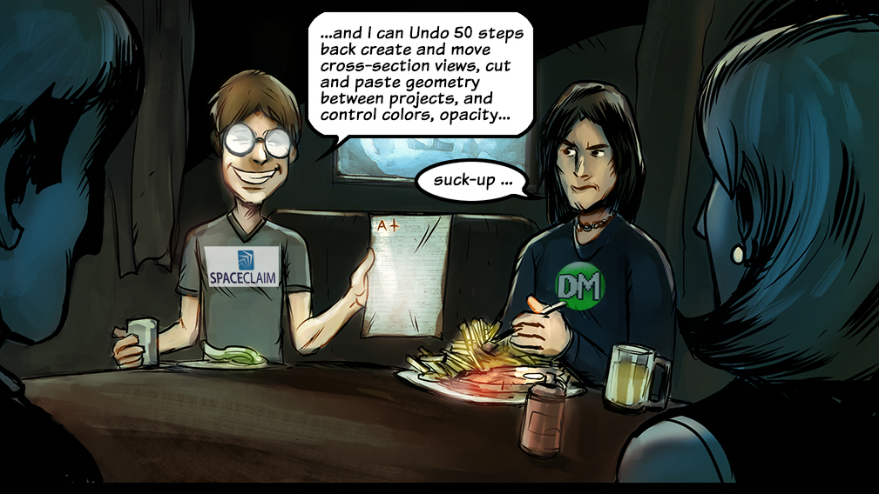
http://www.epsilonfea.com/fea-graphic-novel/
Notes:
Want more comics…

Slide 4
Company Overview
Phoenix Analysis &
Design Technologies
Notes:
PADT

Slide 5
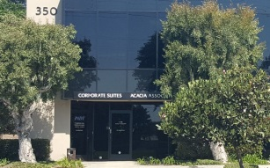
“We Make Innovation Work”
PADT is an Engineering Services Company
Mechanical Engineering Products and Services
21 years of growth and happy customers
Any Industry, World Wide
Small to Large Companies
HQ in Tempe, Arizona
Offices in
Torrance, CA
Littleton, CO
Albuquerque, NM
Murray, UT
CEI in Phoenix
Reseller for: ANSYS, Stratasys, Flownex, Geomagic
Our own Products: CUBE Simulation Computers and SCA 3D Printed Part Cleaners
www.PADTINC.com

Slide 6
People
84 Experienced and Motivated Employees
Education is Critical to Company Success
Industry Experience Plays more Significant Role
Diverse Disciplines
Mechanical, Electrical, Manufacturing Engineering
Technicians, Business Administration, IT
Sales Staff

Slide 7
1000’s of Customers

Slide 8
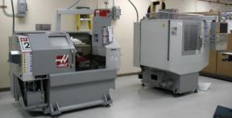
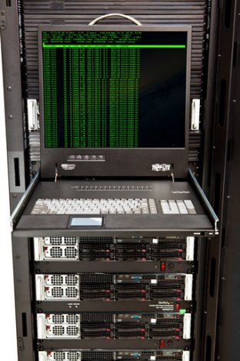
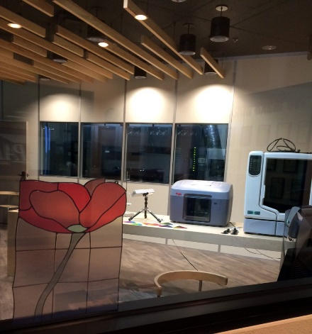
Facility & Tools
25,000 ft² at ASU Research Park in Tempe, Arizona
40,000 ft² building owned by PADT
Onsite Labs: Clean Room, Medical, General
Machine Shop
Training, Seminar and Meeting Space
Offices in Torrance, California; Littleton, Colorado; Albuquerque, New Mexico; Salt Lake City, Utah.
Robust and Powerful Compute Infrastructure
2,000+ Linux64 cores
Redundant office, database and communication servers
Powerful desktop systems
World-Class CAD/CAE Tools
SolidWorks, Pro/E, SolidEdge, NX, Inventor
ANSYS Product Line
3D Systems & Stratasys

Slide 9
Synergy
Three Business Groups to Provide Focused Resources
Flexibility of People and Tools Across Functions
Sales & Support
ANSYS Sales & Support
Flownex Sales & Support
CUBE Simulation Computers
Stratasys and Object 3D Printers Sales & Support Mentoring & Training
Engineering Services
Semiconductor Equipment
Medical Devices
Alternative Energy
Rotating Equipment
Machine Design
Engineering for Startups
Consumer Products
Simulation Services
Custom Software Development
Manufacturing Technology
3D Printing Services
Scanning Sales and Services
Soft Tooling
Manufacturing Consulting
Injection Molding Consulting
SLA – SLS – FDM – Polyjet
www.PADTINC.com

Slide 10
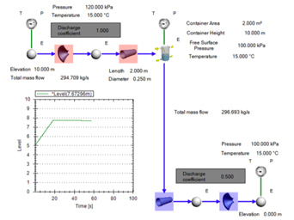
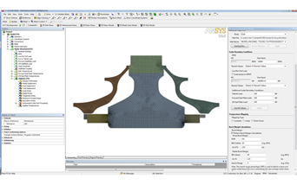
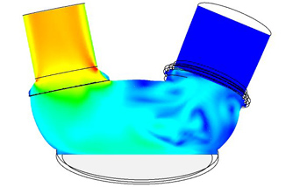
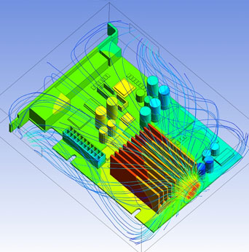
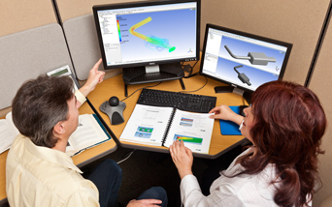
Simulation Sales & Service
World Class FEA and CFD Sales, Consulting & Training
Training & Mentoring
ANSYS, Inc. and Related Training at PADT or on-site
Classes or one-on-one
Technical Support
Timely, real-world and practical
Consulting
Thermal, Structural, Dynamics, CFD, Electromagnetics and most other mechanical simulations
Tool Customization
Accurate, timely and affordable
Sales
Full line of ANSYS, Inc. products
Flownex Fluid-Thermal System Simulation
CUBE Simulation Computers

Slide 11
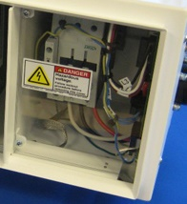
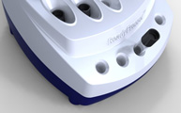
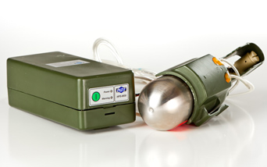
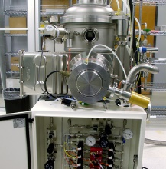
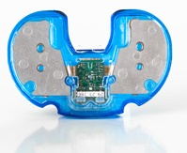
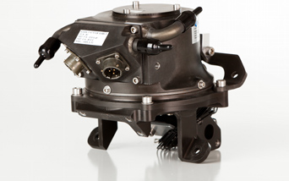
Product Development
Full research, design and development of machinery and systems
Energy Systems
Custom pumps and blowers
Solar Systems and Sub-Systems
Alternative Energy and Hybrids
Semiconductor Manufacturing Equipment
Subsystem design
Alpha machine development
Medical Devices
Complete device development and design
Considerable surgical device experience
QSR compliant process
Other
Any complex and difficult system that requires a high level of engineering

Slide 12
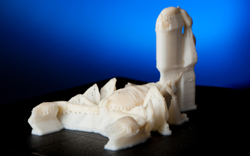
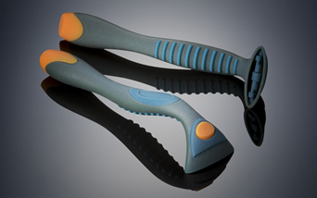
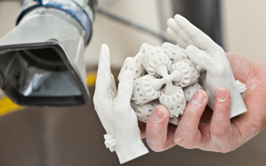
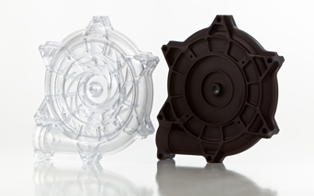
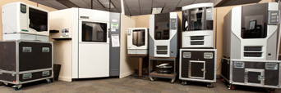
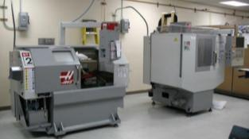
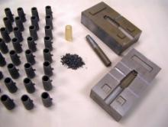
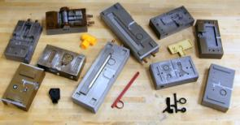
Manufacturing Technologies
Stratasys FDM and Polyjet Sales & Support
On-site High Quality Rapid Prototyping
Selective Laser Sintering (SLS)
Stereolithography (SLA)
Fused Deposition Modeling (FDM)
PolyJet
Model Making
NC Machining
Rapid Injection Molding
Soft Tooling
Epoxy Tooling
Liaison to offshore manufacturing
Inspection
Cross Sectional and Laser Scanning
Manufacture and Distribute Support Cleaning Systems - SCA

Slide 13
PADT Blog on All Things ANSYS: The Focus
The Focus: www.padtinc.com/blog
Notes:
The Focus, PADT’s Blog is an excellent source of content and information

Slide 14
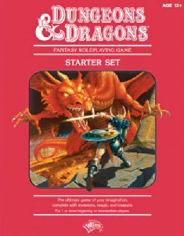
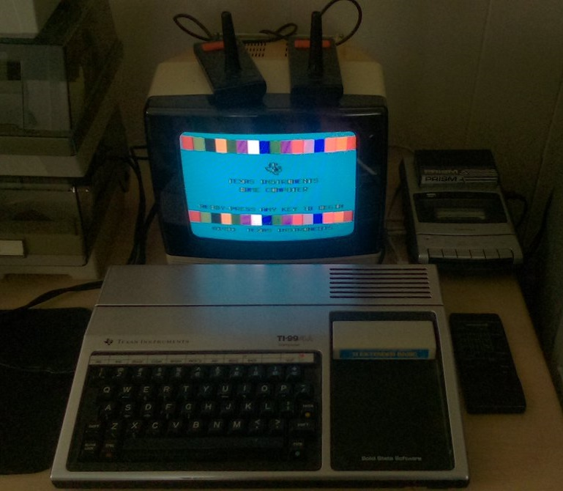
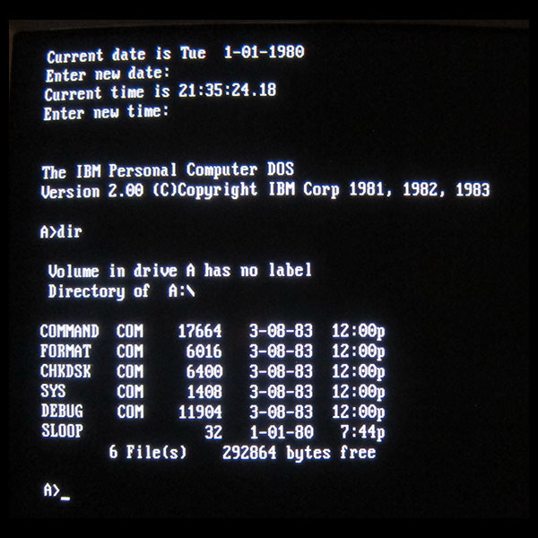
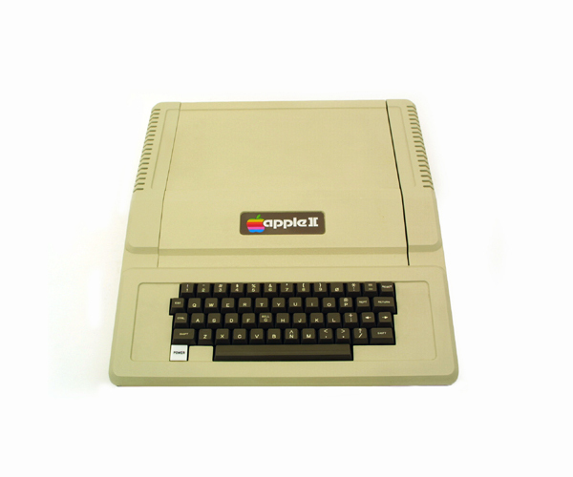
David…
1977
Notes:
Grew up in Minnesota
B.Sc in M.I.S.
Began using computers in the 2nd grade. Apple ][ - The Oregon Trail
BASIC, DOS
Musician, horses, motorcycles and loved growing up in Minnesota

Slide 15
Trends in the world of Engineering Simulation
The hardware and software environment in our Numerical Simulation world is just plain different. It has been a sustained progress type of year
All of the portal’s!
Internet of things - http://www.padtinc.com/iot/
The networking of all with the purpose to collect and exchange data
We love information that our data provides
Notes:
HPC – Advanced users & Novice Users
Oooooh The Portal → look into the future

Slide 16
Roadblocks for Engineering Simulation
Seek Balance And Do Not Fear
FOMO: The fear of missing out
1. Costs
- What is your budget
- What is a balanced compute system?
- Redundancy, Tracking, and Monitoring to watch for system hardware or software failures
-- Kills performance & solving efficiency
-- Quality platinum level components in reality are less than 5% what if can kill a system
-- You are better off losing a job or data on a rare occasion than having a slow system
2. Security can be just as bad
- Many bad IT decisions made because of low probability security threats – isolate the machine instead.
3. Example:
- A fast-and-loose system may be down 5% of the available run time
- A “tight” system is 25% to 50% slower.
Notes:
The major roadblocks
Misinformed/Uniformed IT guys
No incentive to spend my time leaning ANSYS. I had a desire and tenacity to learn about how numerical simulation software stressed the hardware. My desire is to push the code and hardware to the limits.

Slide 17
My life in IT
I may not understand or we just don’t know what the heck you do.
IT has constant bombardment and expectations from end-users wanting the latest greatest in toys.
You may need to fix their perception of you.
Take your IT Manager out to lunch!
Notes:
1. Numerical simulation is different than a file or web server
2. Costs us money - $$$
-- A compute system that is not optimized for numerical simulation
-- Loss of a substantial amount of solve iterations per day
(Just when you needed them the most!)
-- The engineering Sim guys missed their deadline (Money)
-- Slower to getting your product redesign to the market

Slide 18
System Configuration
Set it & Forget it?
Well sort of…
- At minimum
1. Block out a yearly maintenance window on HPC clusters
2. For HPC/numerical simulation workstations, a minimum of every six months
What do I look for when running a maintenance?
- Hardware firmware and bios
- Hardware drivers
- Operating System patches
Horror stories for you
File system corruption
System halts
low-level updates not done since implementation.
Notes:
Pet peeve rant → updates/firmware/bios not being installed
why? Takes time to learn another low level tool
Fear → Did I just make it worse?

Slide 19
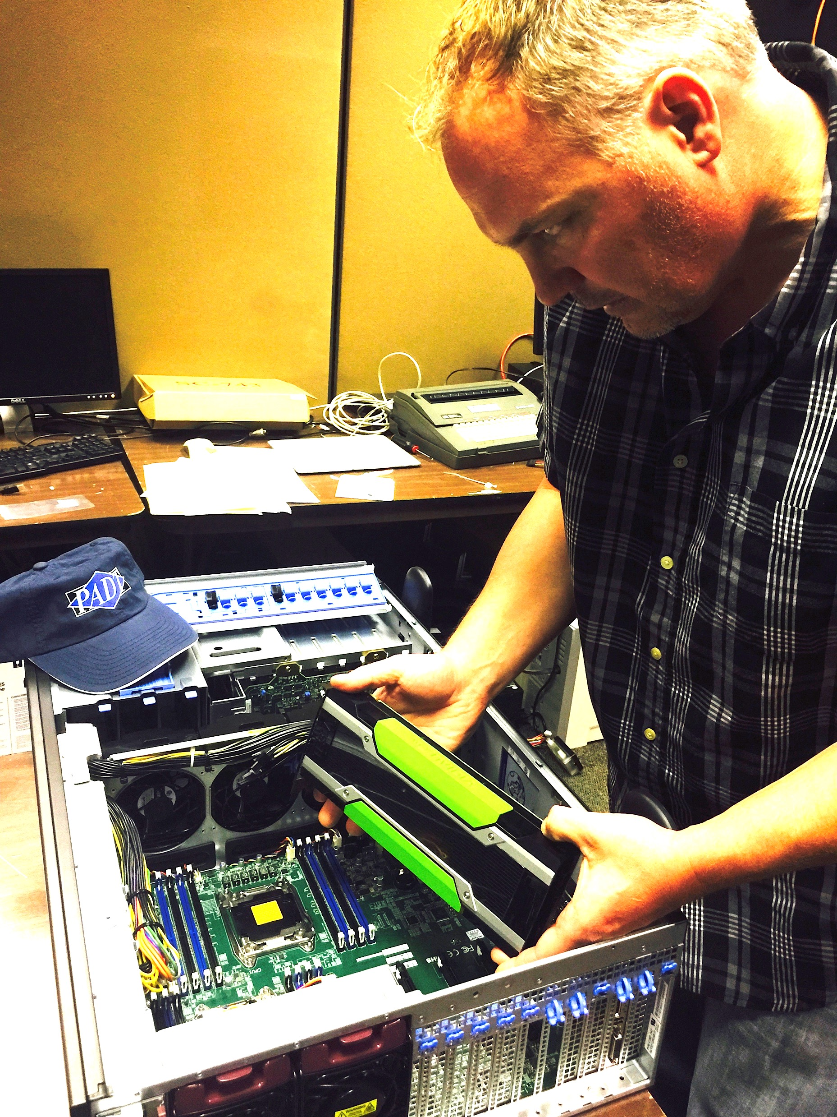
GPU Computing
What is the deal with GPU’s?
GPU’S Explained
GPU’s and ANSYS Software
Lessons learned on Implementing GPU’s
Recommend using more than one
Recently used 10 Nvidia Tesla’s
Ten Compute Nodes
Bottle neck – CPU Interconnect was 10Gbps
System configuration:
Extreme speed
High Ram to keep solve in memory
Notes:
Graphics Processing Unit
A graphics processing unit (GPU), also occasionally called visual processing unit (VPU), is a specialized electronic circuit designed to rapidly manipulate and alter memory to accelerate the creation of images in a frame buffer intended for output to a display.

Slide 20
GPU Computing
When running distributed your CPU Interconnect speed is just as critical
100Gbps Ethernet now available
56Gbps
Notes:
Graphics Processing Unit
A graphics processing unit (GPU), also occasionally called visual processing unit (VPU), is a specialized electronic circuit designed to rapidly manipulate and alter memory to accelerate the creation of images in a frame buffer intended for output to a display.

Slide 21
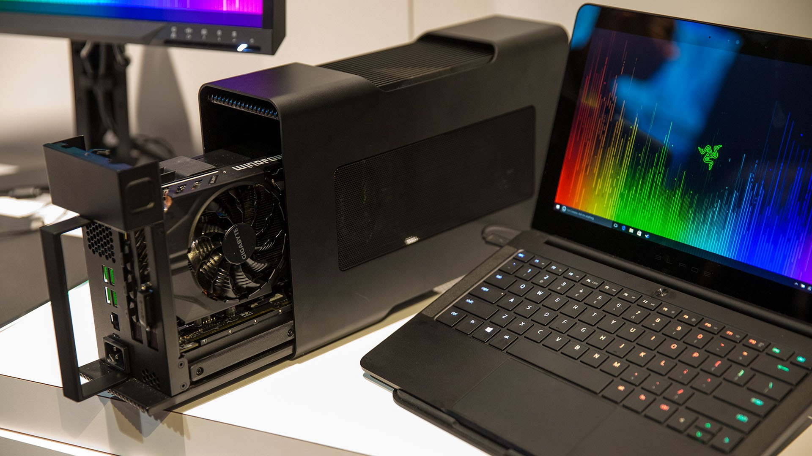
GPU Computing (Cont.)
Razor Core
External GPU Bay
Thunderbolt™3 – USB-C
The future
Limitations
Notes:
I absolutely love this product. Huge upside!
Not there yet → need faster bandwidth to be able to sling one of these off of your laptop to run GPU Accelerated solves
40Gbps – 4x of 16x bandwidth

Slide 22
CPU - INTEL yay! AMD ☹
CPU update XEOM E5-2600 v4 (Broadwell)
Officially launched
Socket compatible replacement
CPU | Xeon E5-2600 v3 (Haswell-EP) | XEON E5-2600 v4 (Broadwell-EP)
Cores Per Socket | Up to 18 | Up to 22
Threads Per Socket | Up to 36 threads | Up to 44 threads
Last-level Cache (LLC) | Up to 45MB | Up to 55MB
QPI Speed (GT/s) | 2 x QPI 1.1 channel speed 6.4, 8.0, 9.6 GT/s
PCIe Lanes/Controllers/Speed(GT/s) | 40 /10 / PCIe* 3.0 (2.5, 5, 8 GT/s)
Memory Population | 4 channels of up to 3 RDIMM or 3 LRDIMMS | Added + 3DS RDIMM
Max Memory Speed | Up to 2133 MHz | Up to 2400 MHz
Notes:
INTEL yay!
AMD ☹ - the quad socket architecure is still strong even after all of these years
- I expect existing AMD servers that are currently in data centers to be sent to the scrap yard in two to three years
- AMD needs something big to knock INTEL off #1

Slide 23
Disk I/O
Understanding Simulation, I/O
Extremely heavy I/O
Need for speed
Bring me back that snappy feeling
Notes:
RAID 50 – High I/O and data transfer rates
Latency and # of que depth on SSD mean you get that nice – snappy feel
Enteprise SSD – 5 years

Slide 24
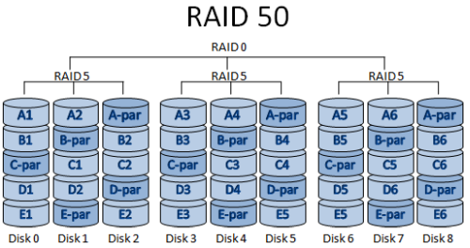
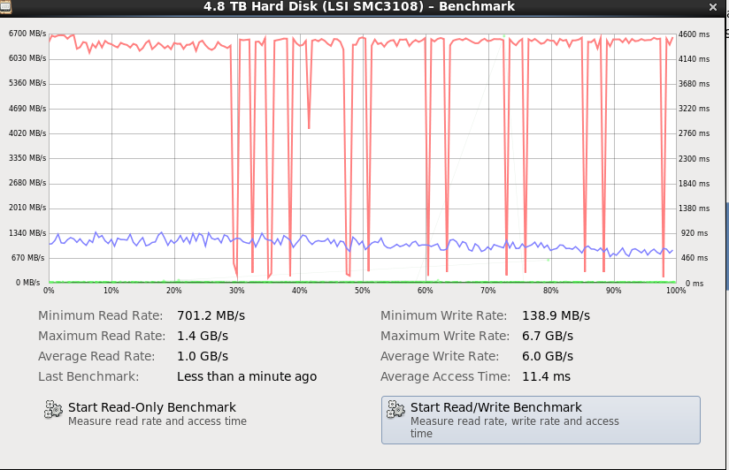
Disk I/O – (Cont.)
RAID Basics
Redundant Array of Independent Disks
Things to Avoid
Raid 1, Raid 5, single disk
What I use?
Notes:
RAID 0 & RAID 50 ONLY
SAS 3.0 (12Gbps) Max Read 1.4GB/s
MAX Write 6.7GB/s
11.4 ms

Slide 25
It’s a Solid State
Next Generation SSD Technology
>7x lower latency than SAS 3.0(12Gbps)
6x the bandwidth of SATA 3.0(6Gbps) SSD’s
Highest Performance up to 3GB/s Read and 460K IOPS Per drive
Satisfies the Performance Demands of VDI, Cloud, Storage, and Server Caching
2.5” U.2 (SFF-8639) Form Factor serviceability advantage
vs. standard SSD cards
Hot-swap protects against surprise add/remove
Notes:
NvMe!! Save me
7x Lower Latency ! Even less waiting in line
6x MORE bandwidth

Slide 26
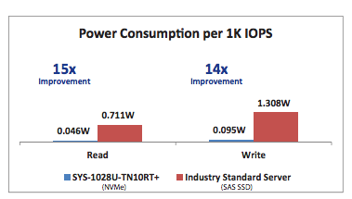
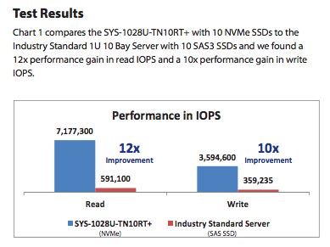
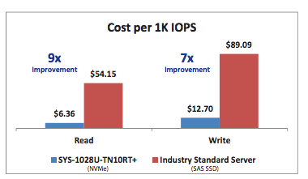
It’s a Solid State (cont.)
Sustained progress?
I/O takes a leap forward
Notes:
U.2 – the next generation in speed/performance. A must of the dollar
12x Perfomance increase
10X Performance increate in Write

Slide 27
Tools
Biggest asset is your ANSYS Solver Output File or ?
- What to look for in your output file
1. ANSYS FEA
2. ANSYS CFD
HPC Cluster Management Tools
Is it time?
- When is it time to take it to the next level
- Implement an HPC Compute Cluster Manager
1. Ganglia
2. Bright Compute Cluster Manager
3. Windows 2012 R2 Standard HPC
-- Diagnostic tools
4. Resource Monitoring
5. IT and Engineering Management Reports
Notes:
What a bunch of Tools
-just did a little bit deeper!
Spend 20-30 minutes to run a ANSYS benchmark on your machine.
- What does the file reveal? Compute Bound? I/O Bound
http://www.padtinc.com/blog/the-focus/ansys-mechanical-io-bound-cpu-bound

Slide 28
Solving Across Your Enterprise Network
Scheduling & Queuing Systems
- This means money!
1. “Linux costs money” – Ken Camino
2. Open Source vs. Third Party supported
-- Windows 2012 R2 Standard HPC Management
-- Bright Compute Cluster Management
-- Torque with MOAB
a) Torque is open source and free
b) MOAB you will need to purchase licenses
Notes:
- Pick one and spend time setting it up correctly
1. Manage jobs of multiple people
2. Many are smart enough to look at resources and properly deploy
3. Better feedback and failure recovery

Slide 29
Solving Across Your Enterprise Network
Why We Solve Remote
- Use shared resources
- Systems optimized for solving, not pre/post
- Be able to do other things on our desktop
ANSYS RSM & ANSYS EKM
- Default submission tool
- Built in to ANSYS, easy to use and deploy
- Handles moving files around for you
- Not a queuing system, but can be linked to queuing software
Notes:
Just solve, get readt, Do it!

Slide 30
ANSYS EKM
Notes:
Explore ANSYS EKM/Ask your ANSYS sales representative for a DEMO!
Portals!!

Slide 31
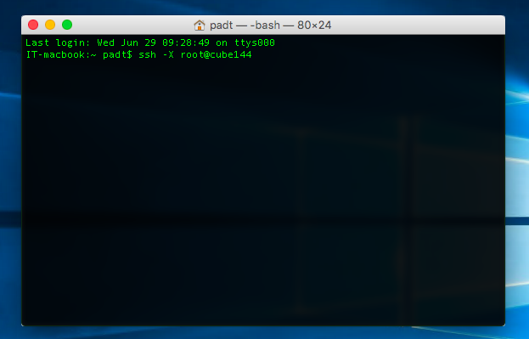
Some Challenges
Manual Remote Solve
- Do you have access?
1. SSH, VNC, Remote Desktop
- Move Files:
1. Mounting is best
2. Or use FTP, SCP or WinSCP
Visualization on Remote Systems
- Really changing and getting better
1. Remote Desktop or VNC
2. NX
3. NICE
Network Speed is critical
- Hardware VPN for remote
- Point-to-Point connection is best
- Dedicated Network within a LAN or WAN

Slide 32
Benchmark Tools
ANSYS Benchmark Suite
Available download through the ANSYS Customer Portal
Linux Live CD
Disk Utility
This is how I quickly measure disk I/O
USB boot drive for updating firmware and BIOS
Using the programs and real world test model to show speedup
CAD Programs
UGS NX
PRO/e
Notes:
I consistently use ANSYS sp5 and any of the FLUENT benchmarks
Aircraft 2m
Truck Poly 14m

Slide 33
System Configuration
The Reality Of Benchmarks
- ANSYS standard benchmark models
1. AMD
2. INTEL XEON v2, v3 & v4 CPU benchmarks
- This data can be used to prove the case and need for:
1. Increased HPC Compute hardware
2. Increased amount of ANSYS HPC licensing
High-Speed interconnects make a difference
- But they and your software need to be configured correctly
- InfiniBand
- Distributed computing, Using MPI is critical
Install the Platform MPI on your numerical simulation machines
INTEL MPI is best with latest generation INTEL XEON CPU’s
MS MPI on Windows HPC
Also installing platform MPI on your Windows HPC Cluster is okay

Slide 34
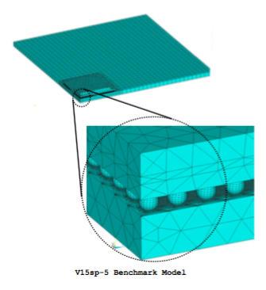
Benchmarks Data – FEA SP5
Notes:
128 core’s running on CUBE model a144i
Fastest Time Spent Computing Solution @ 68

Slide 35
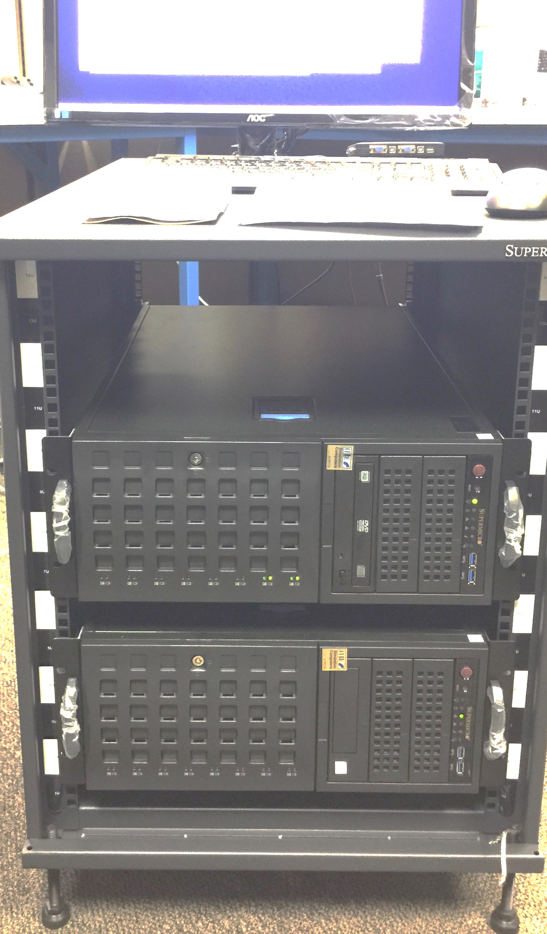
Benchmarks Data – FEA SP5
ANSYS FEA SP5 Benchmark
Cores | 2015 CUBE Intel® Xeon® e5-2667V3
8 | 398.1
24 | 241.2
54 | 89.3
63 | 86.3
72 | 81
128 | 68
 | TIME SPENT COMPUTING THE SOLUTION | TIME SPENT COMPUTING THE SOLUTION
 | IBM Platform MPI | INTEL MPI
Cores | 2016 CUBE w16i-v4 | 2016 CUBE w16i-v4 | The Speedup
2 | 396.1 | 380.9 | 1.04
4 | 239.7 | 229.6 | 1.04
6 | 210.1 | 196.7 | 1.07
8 | 182.9 | 168.7 | 1.08
10 | 167.2 | 161.4 | 1.04
12 | 167.1 | 160.7 | 1.04
14 | 196.1 | 151.3 | 1.30
16 | 184.7 | 161.7 | 1.14
Notes:
128 core’s running on CUBE model a144i
Fastest Time Spent Computing Solution @ 68

Slide 36
Benchmarks – MPI throwdown
Notes:
INTEL MPI is faster on latest generation INTEL XEON’s
http://www.padtinc.com/blog/the-focus/just-one-cube-with-just-one-click-a-1-3x-speedup-for-ansys-mechanical

Slide 37
Benchmarks Data - CFD
Notes:
The INTEL XEON e5-2667 v4 class Benchmark data, is data from one workstation. UNO!
The INTEL XEON e5-2667 v3 Benchmark data, is running across a total of 9 servers

Slide 38
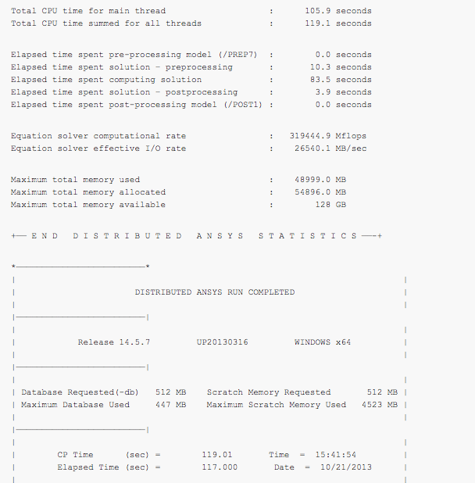
Benchmarks Data
ANSYS .out files
Compute Bound
I/O Bound
ANSYS Benchmarks Test Runs
Determine amount of cores
Run at least 50 iterations
Notes:
Compute Bound / I.O bound. You may have both situations going on…If so try to eliminate Compute Bound or I.O bound
Then re-run benchmark
Verify
Test again even
I/O Bound:
When Elapsed Time greater than Main Thread CPU time
Compute Bound:
When Elapsed time is equals (approx) to Main Thread CPU time

Slide 39
Optimize Ideals
Optimize your hardware for what you do
- Run the correct benchmarks that fit your field of expertise
Don’t let fear drive your hardware, let speed drive it
Check with experts to make sure you have the Software configured correctly
- ANSYS software reseller or community
1. www.xansys.org
2. http://www.ansys-blog.com/
3. www.padtinc.com/blog
Notes:
Do not fear
Check these out!

Slide 40
Next Steps
Next steps if you HAVE compute hardware:
Review your hardware, software, and configuration every six months
- Compute Bound?
- I/O Bound?
Upgrade or reconfigure to get greater value
Add capacity and/or speed
- If memory bound, RAM, RAM, RAM
1. Order of magnitude speedup
- CPU upgrade
- GPU/Accelerators
- Buy more ANSYS HPC tasks licenses!
- Disk space is cheap, spending time dealing with files is not
Have an outside party do an evaluation and make recommendations
Notes:
Just Do it!

Slide 41
Next Steps (cont.)
Next steps if you NEED compute hardware:
Gather a group of benchmark cases
Measure your current performance (for ROI calculations)
Buy for speed, not fear
Remember that Simulation is Different
Does your hardware & software vender truly understand numerical simulation?
- Get multiple quotes
- Ask your ANSYS software reseller for tips
- Read the ANSYS manual
-- How I learned how to expand my understanding of ANSYS
-- Distributed or parallel computing
-- Run the benchmarks

Slide 42
Conclusions
Got HPC?
Say Yes to HPC
Does HPC matter?
Does having the right tools to get the job done matter?
Look at module approach for upgrade
- Understand your specific Engineering Simulation process & environment
- What does your company really need vs. what the HPC marketing is telling me that I need
- Workstation, server, department cluster, company cluster
Notes:
Balance between your budget and what your models require
Building blocks - start building your HPC compute cluster – one compute module at a time. Step by step

Slide 43
Questions?

